Slide 1
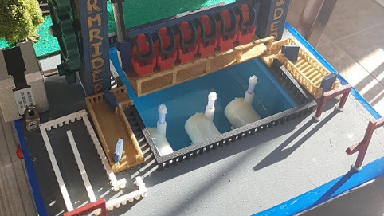

STORM RIDER
By: Jhanvi Shah and Mehreen Aiman

Slide 2
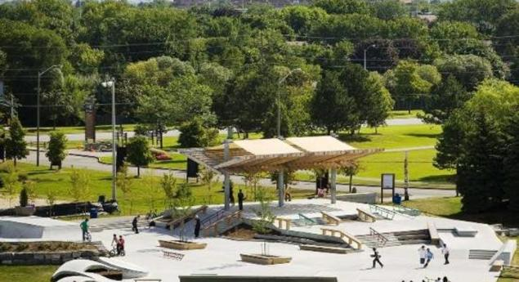
THE PROBLEM
AW Enterprises has been invited to take part in a bid for a contract to design and create a ride driven by mechanisms that would be constructed for a theme park in Chinguacousy Park. This event is hosted by city of Brampton and many other engineering consulting organizations have been asked to design and present an idea for the ride. The ride will have a potential earning of $100, 000 monthly. Seeing that the city is just veering off a recession, this contract will provide AW Enterprises with a major part of the revenue that is needed to continue the company.
Notes:
Mehreen

Slide 3

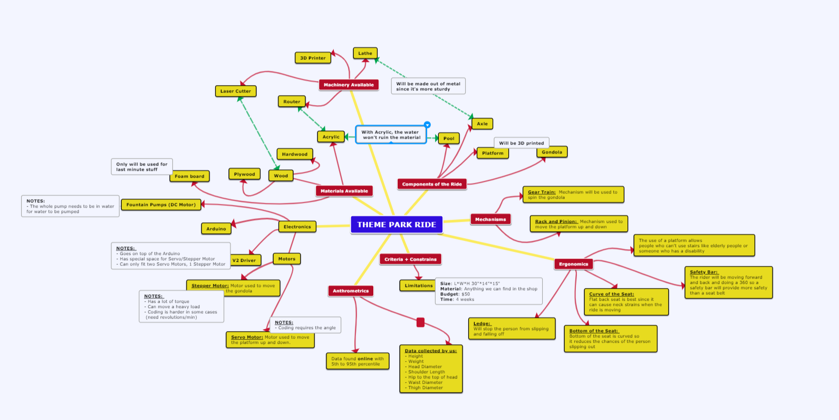
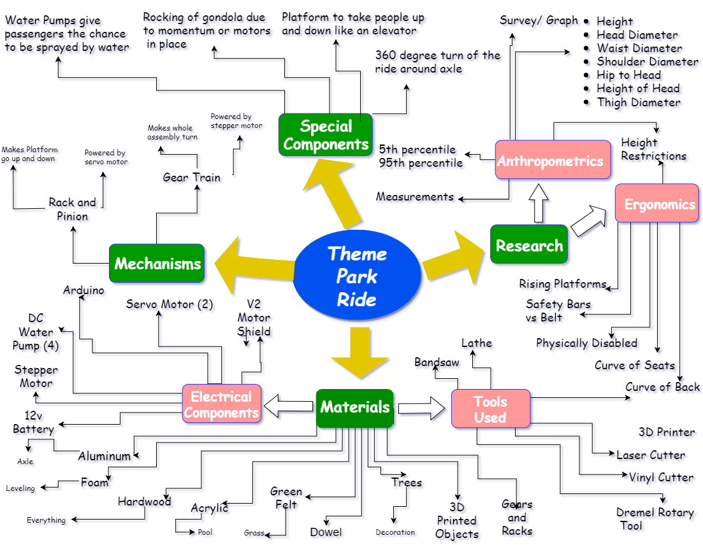
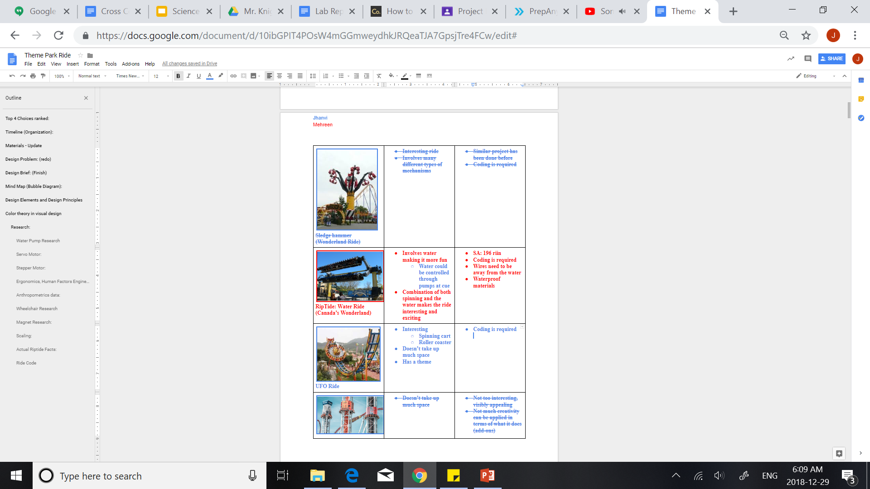

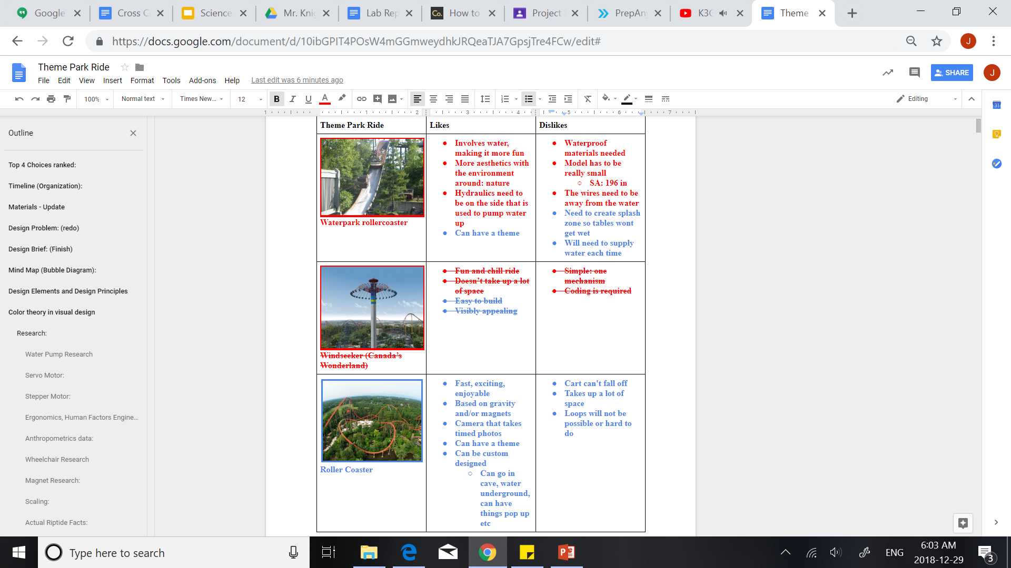
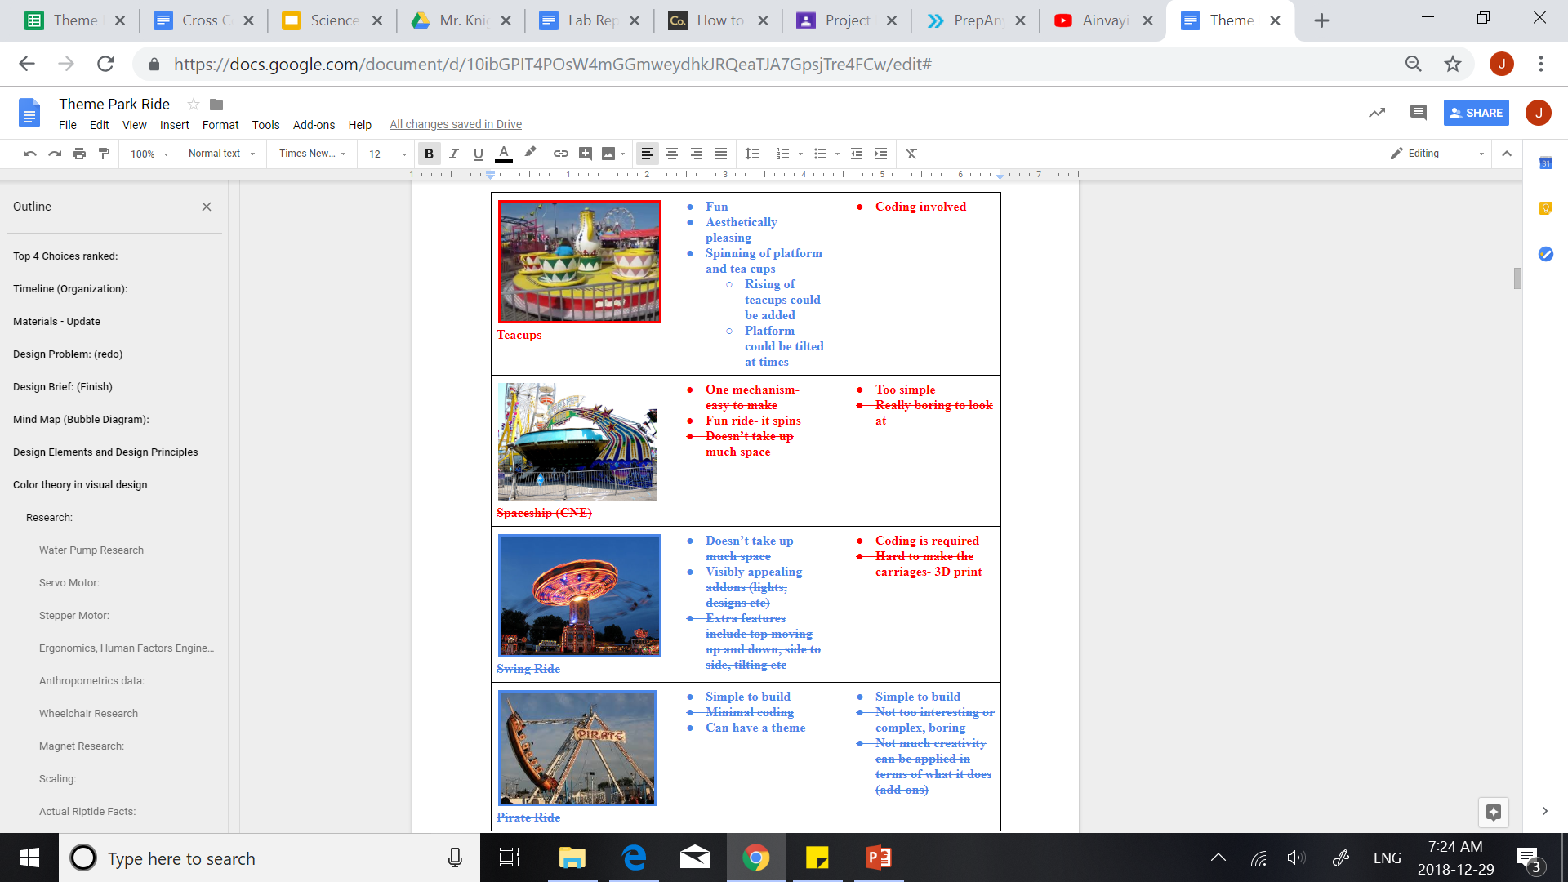
BRAINSTORM
Notes:
Jhanvi

Slide 4
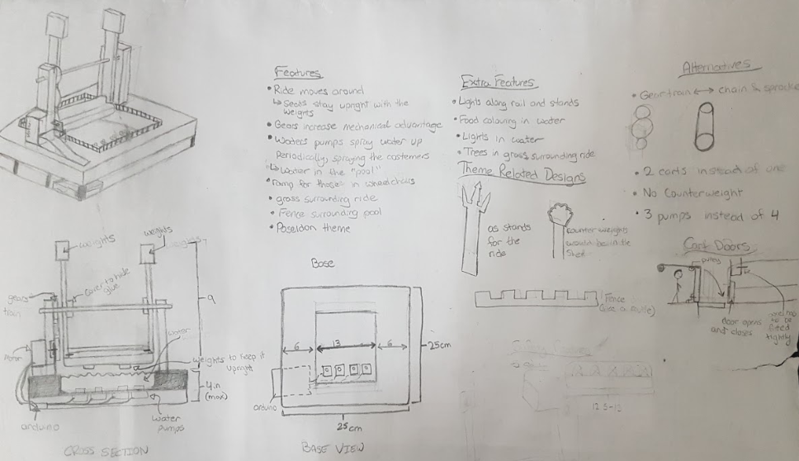
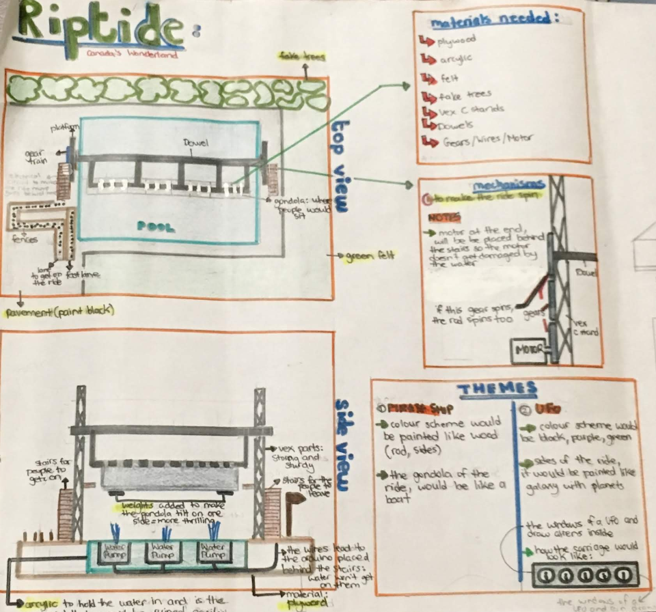
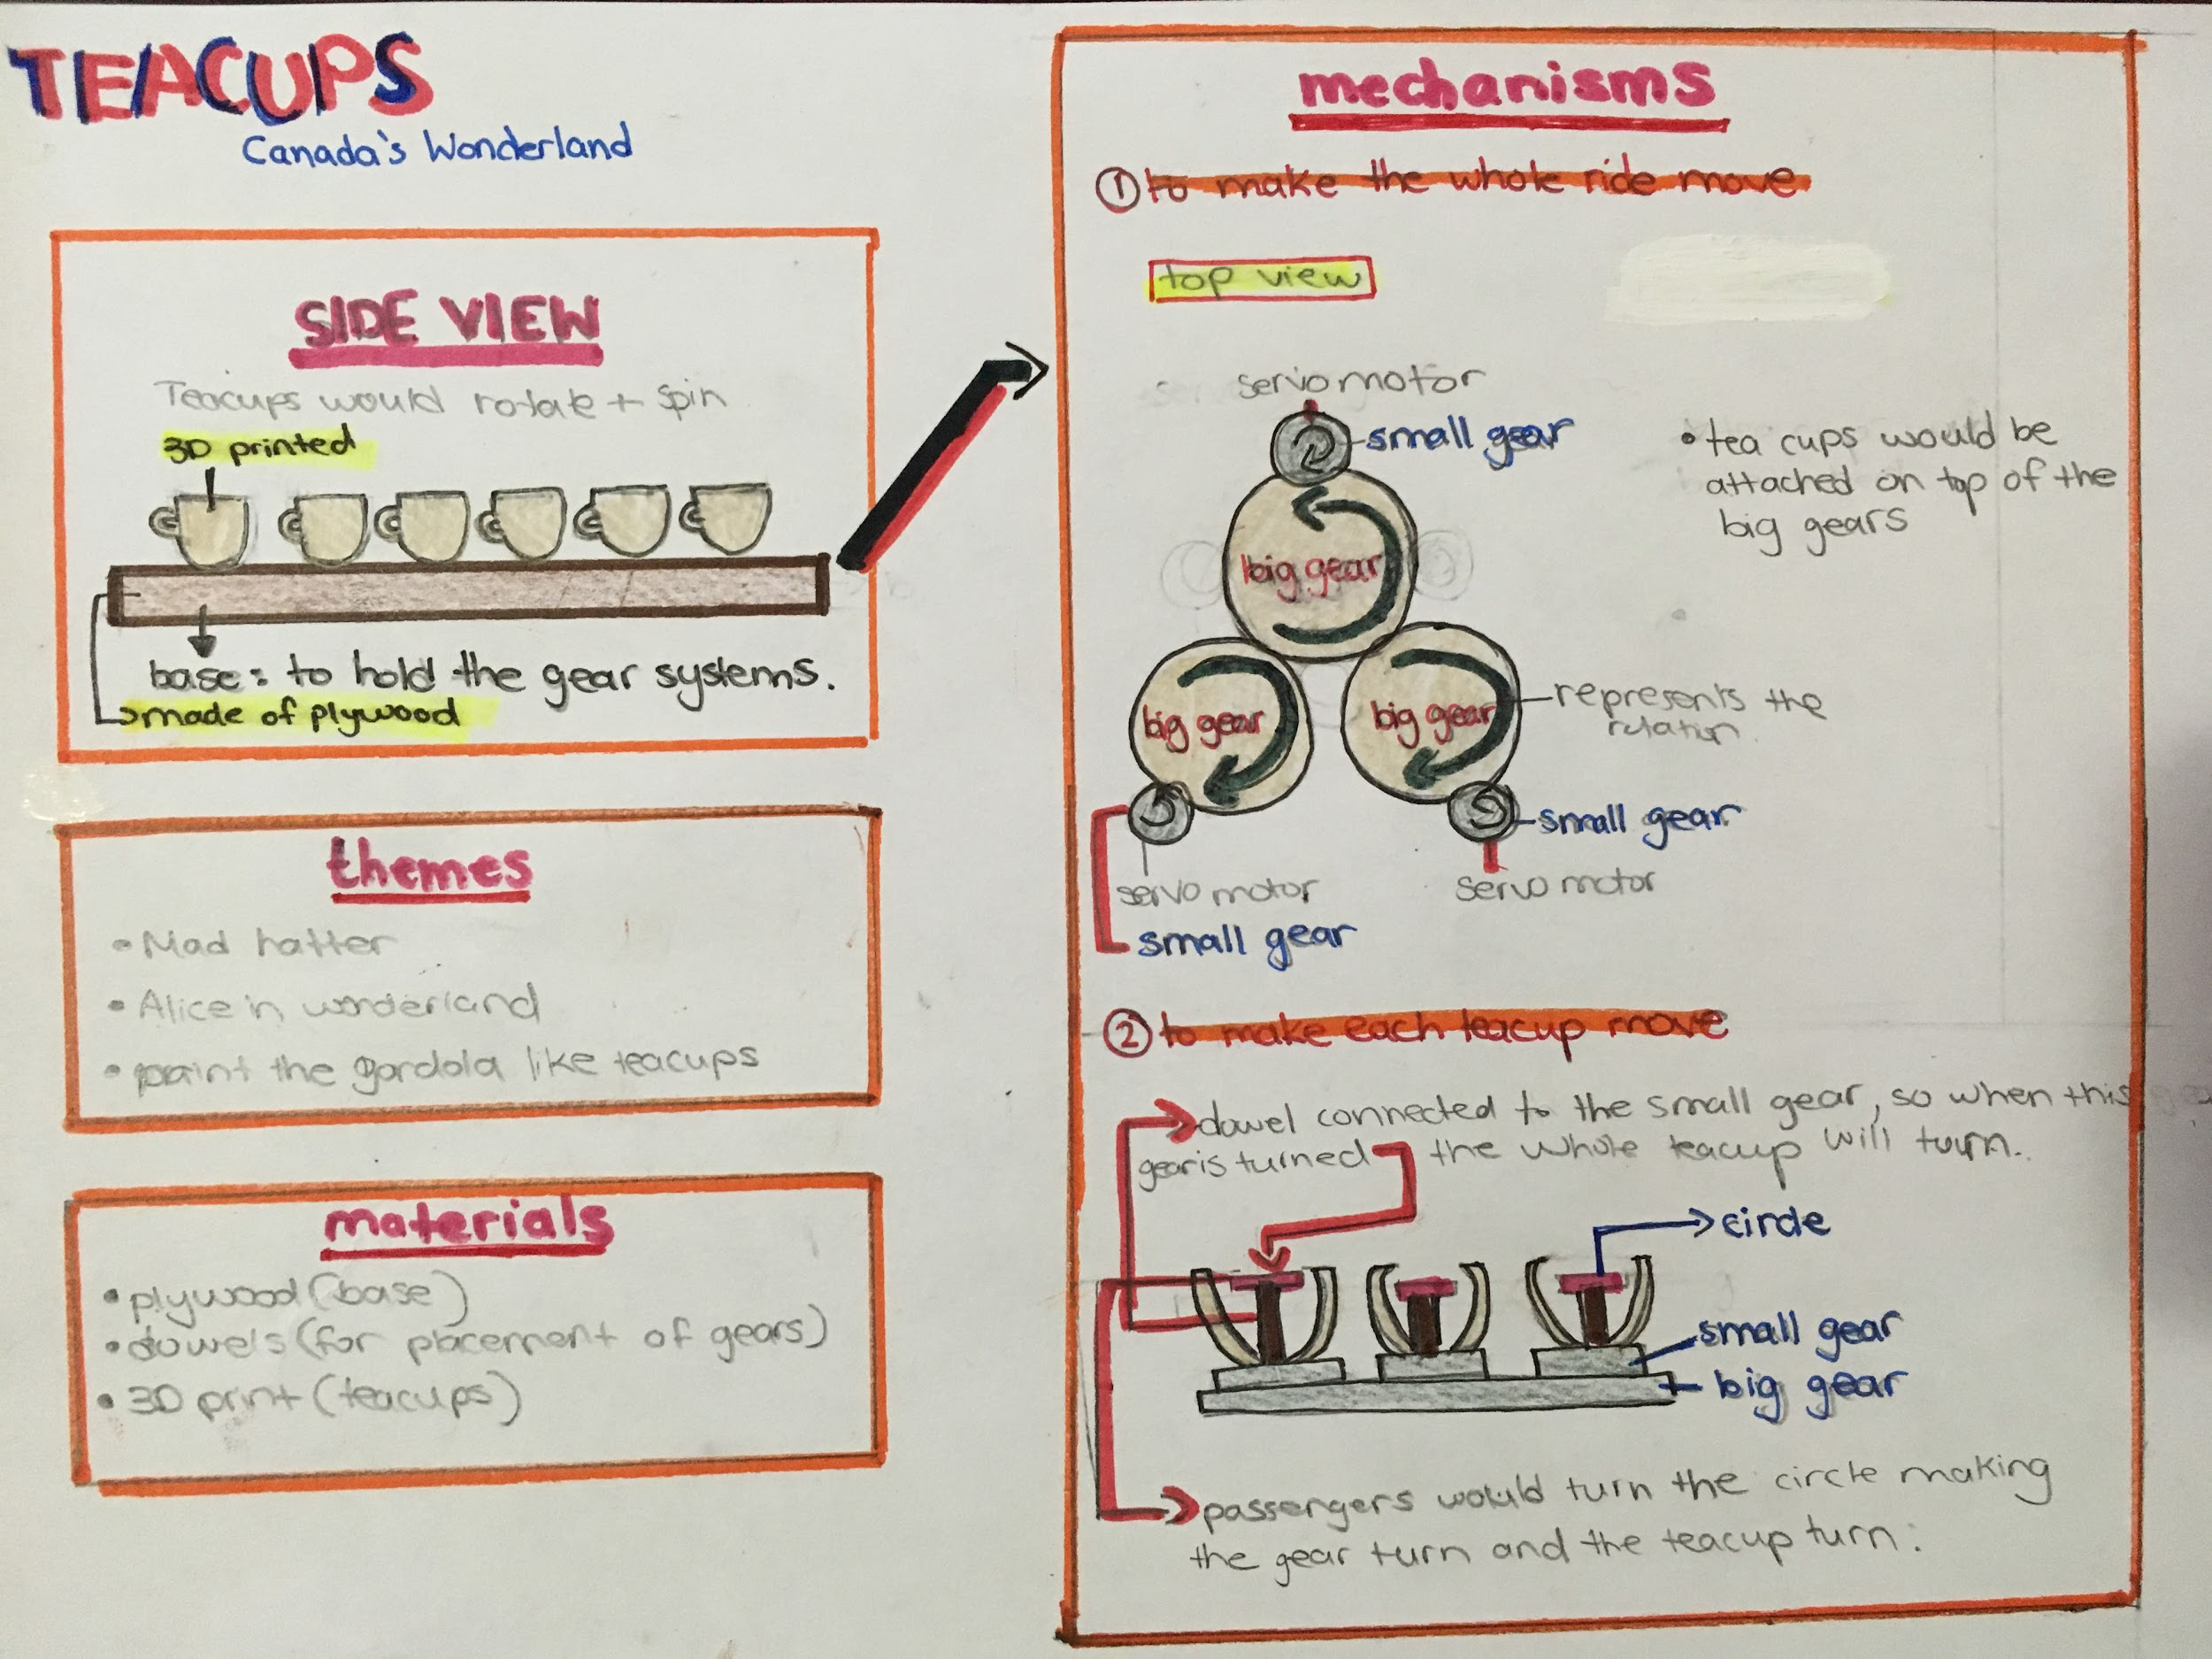
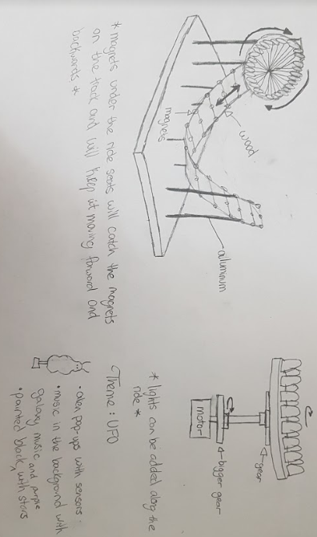
INITIAL SKETCHES
Notes:
Mehreen

Slide 5
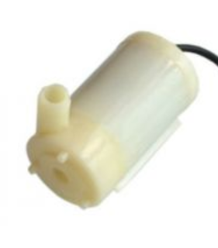
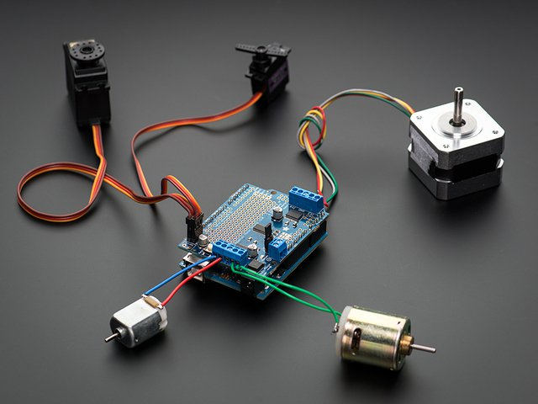
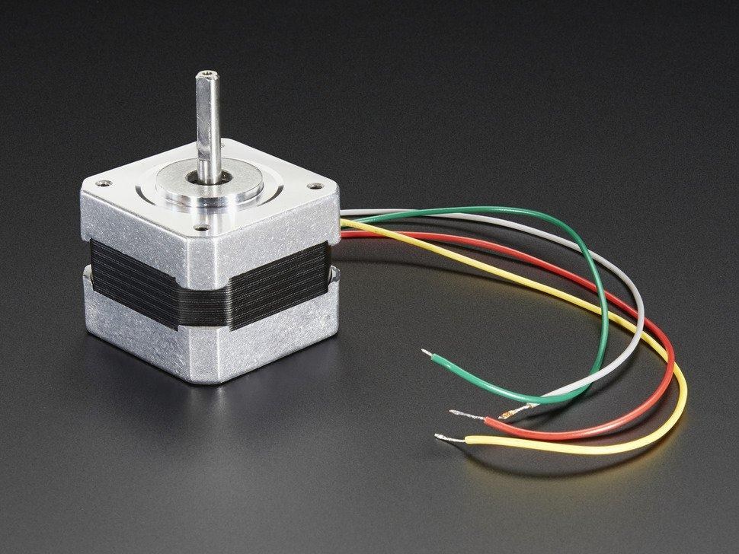
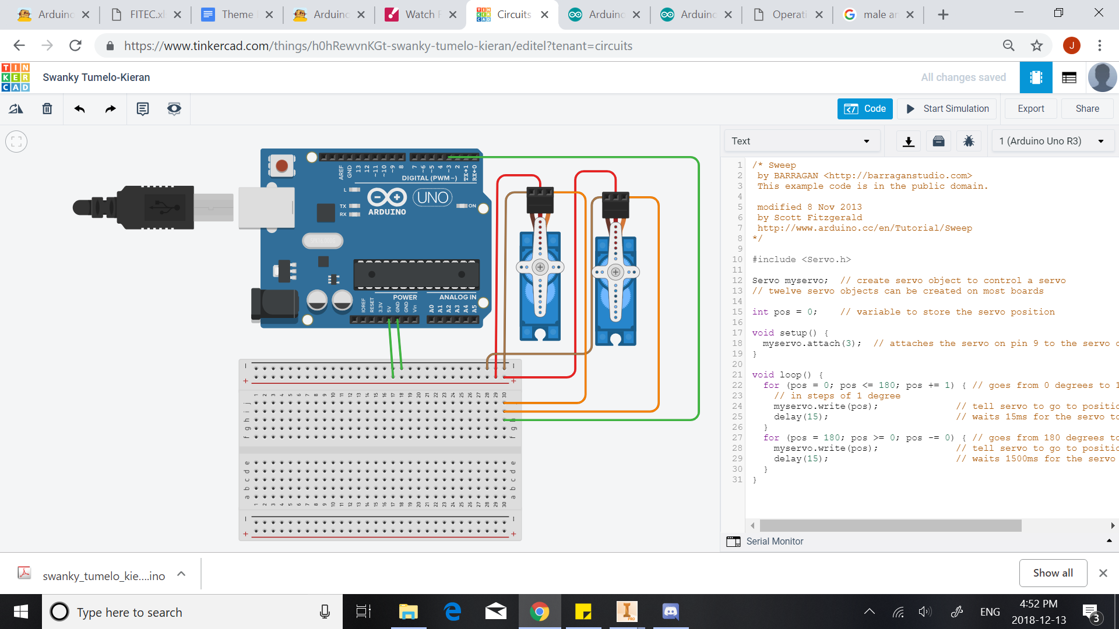
RESEARCH: MOTORS AND CIRCUITRY
Notes:
Jhanvi

Slide 6
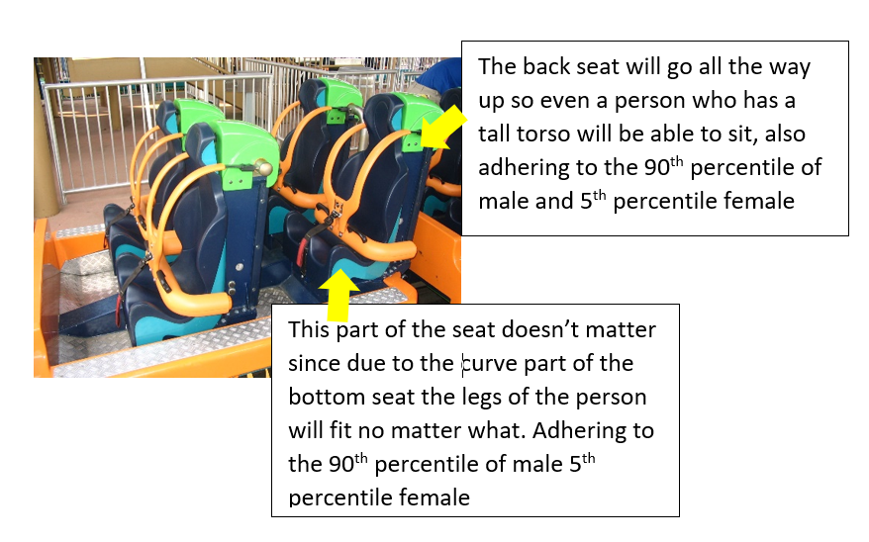
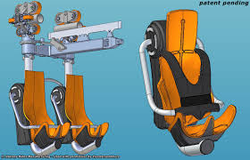
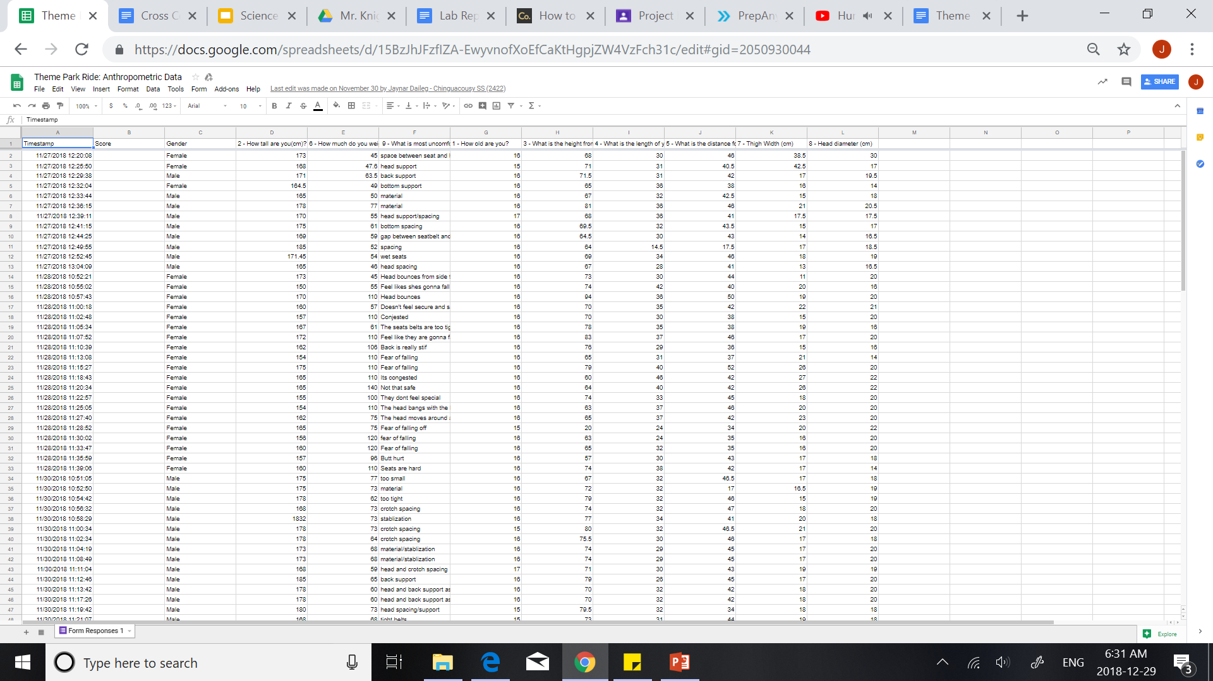
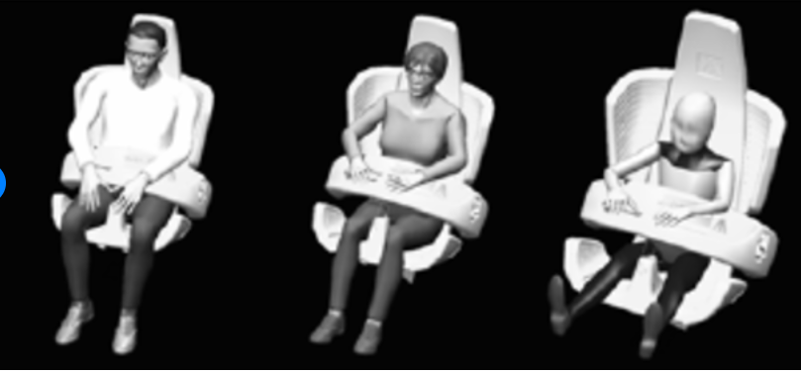
RESEARCH: ANTHROPOMETRIC AND ERGONOMIC
Notes:
Mehreen

Slide 7
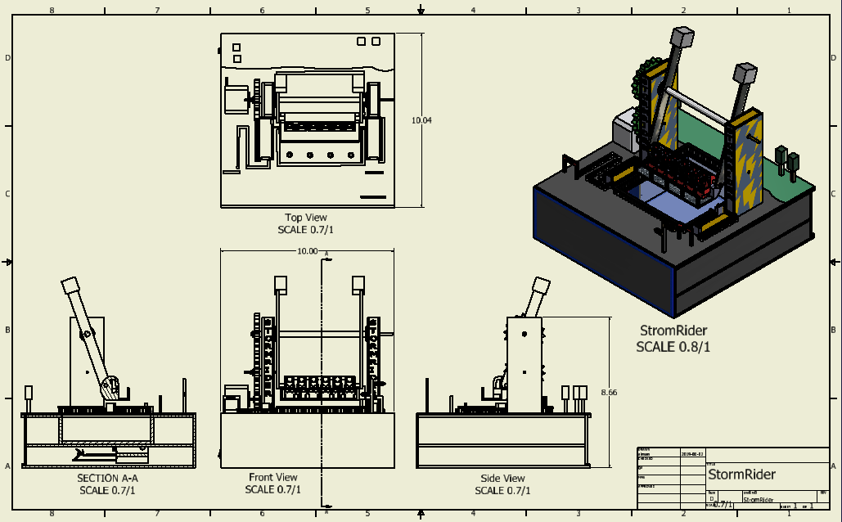
PICK AN IDEA
Constraints
10 x 10 x 12 in
$50
4 weeks to build
Aluminum Composite, Wood, Foam, Machine shop tools, Acrylic
Criteria
Mechanisms
Independent Power Source
One accommodation for a physical disability
Notes:
Jhanvi

Slide 8
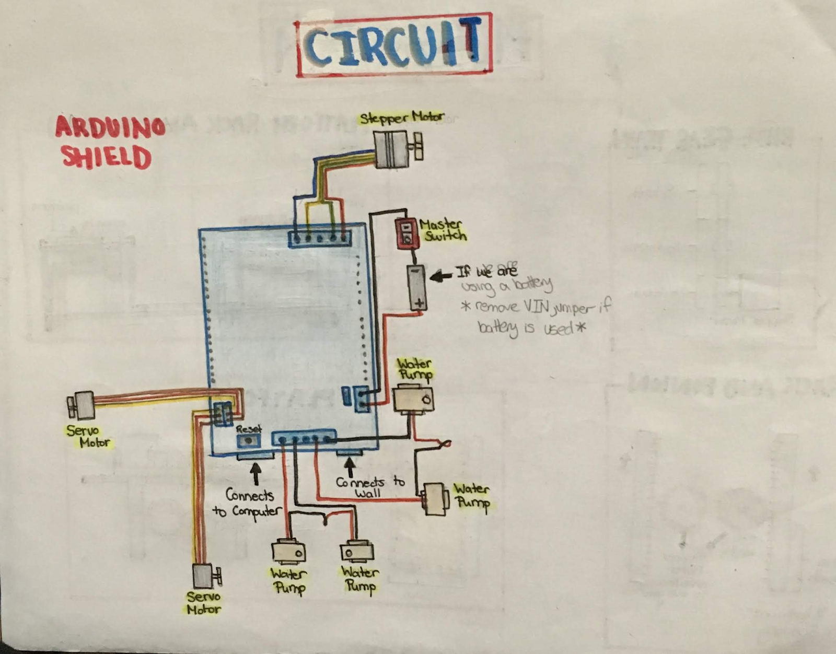
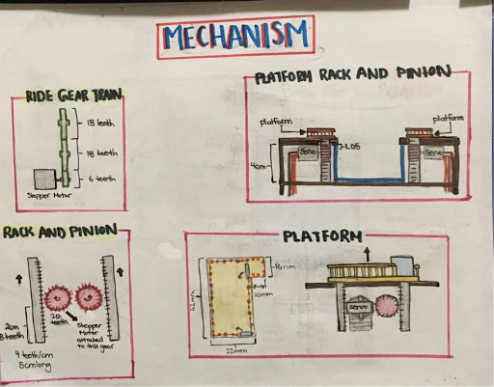
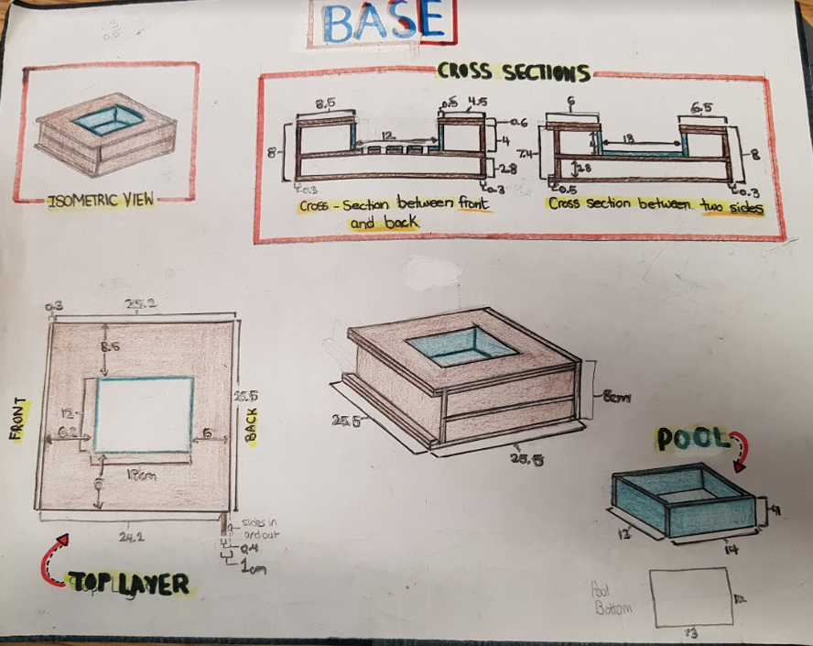
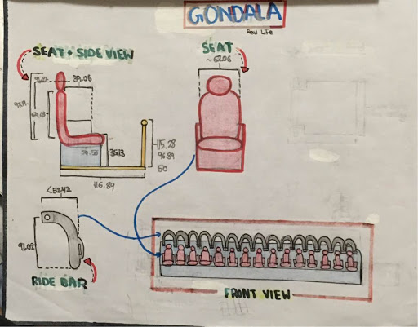
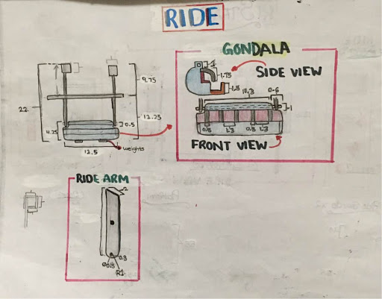
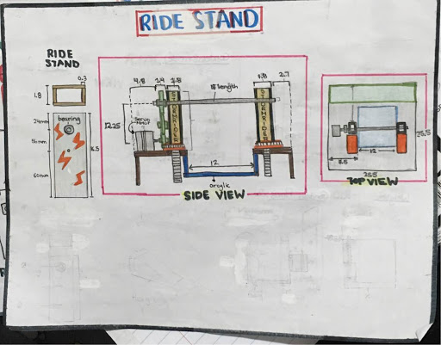
FINAL SKETCH
Notes:
Mehreen

Slide 9
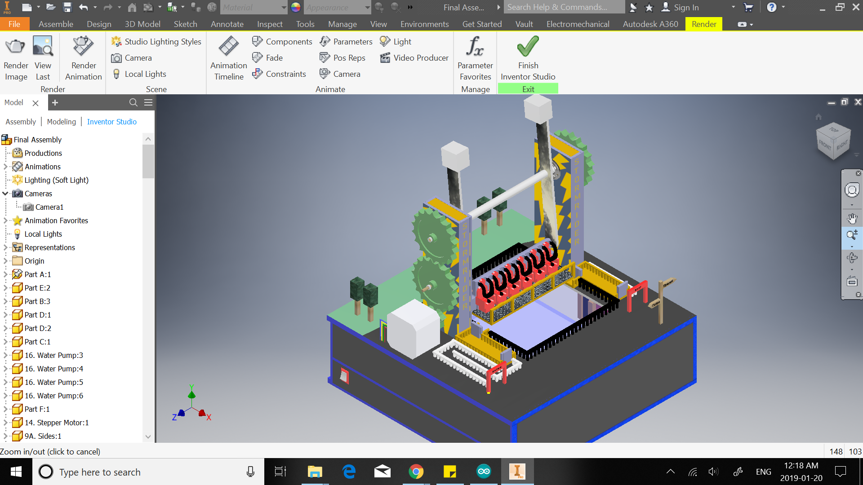
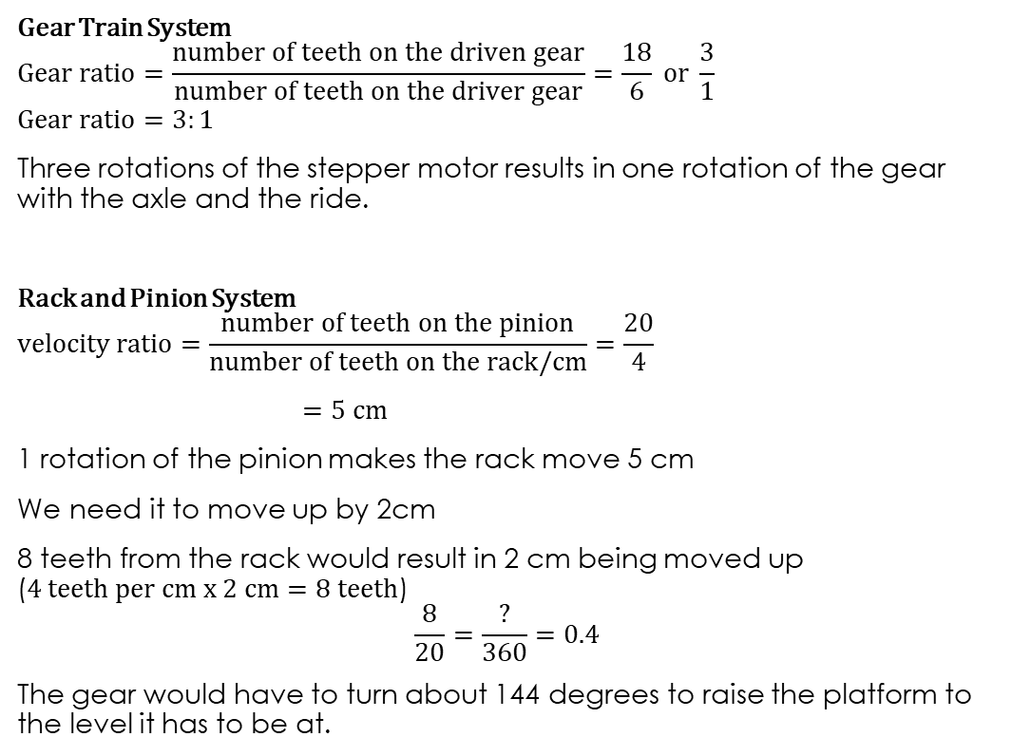
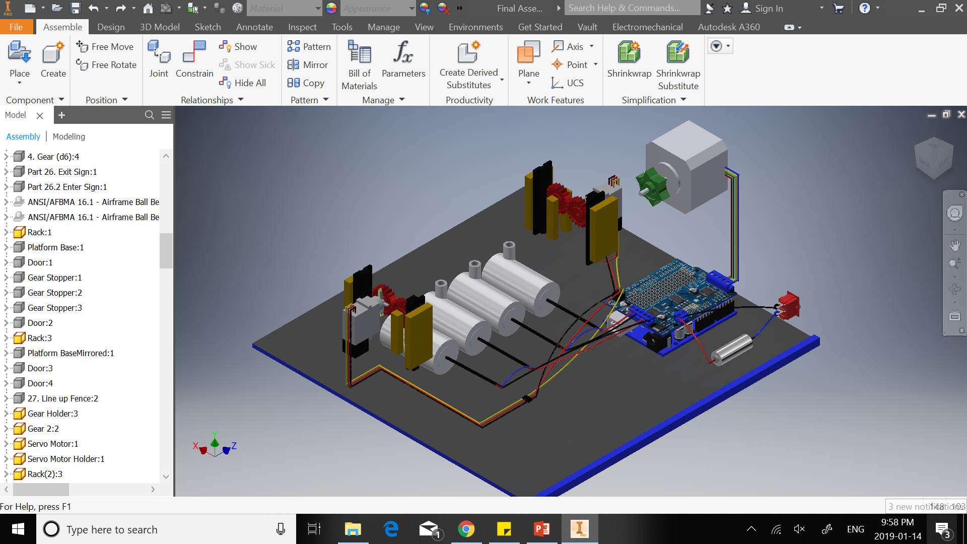
CALCULATIONS
Notes:
Mehreen

Slide 10
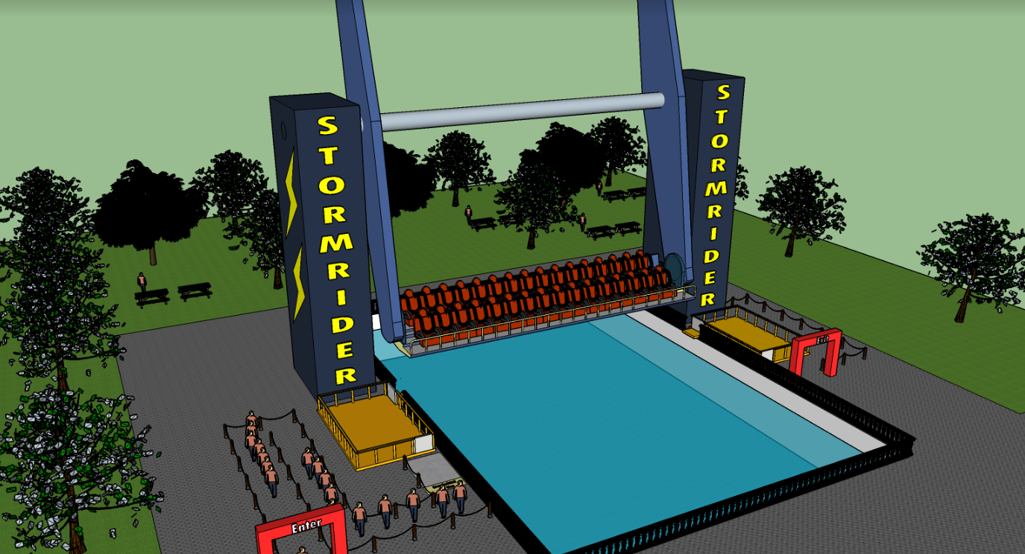
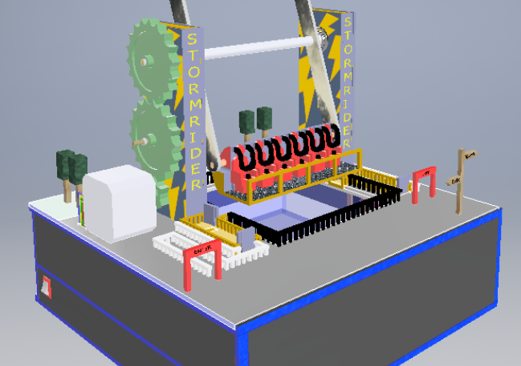
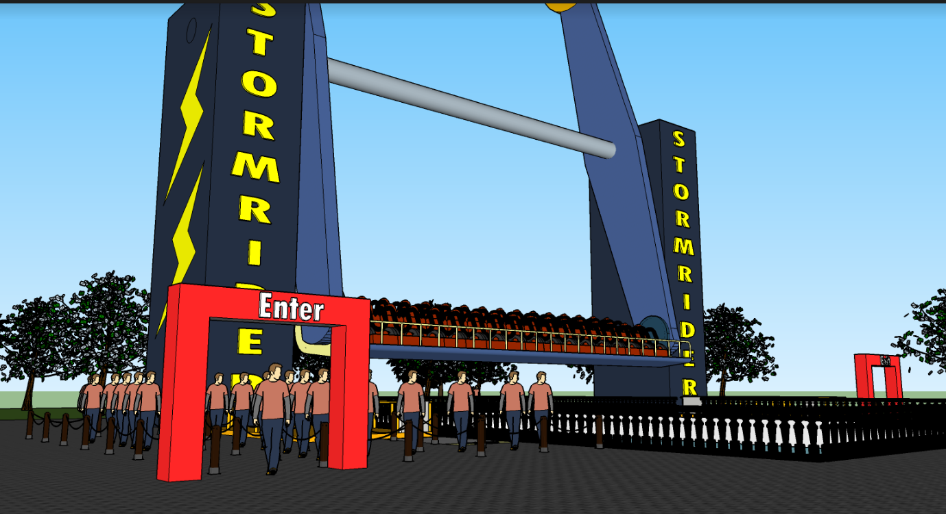
INVENTOR CAD/SKETCH UP MODEL
Notes:
Mehreen

Slide 11
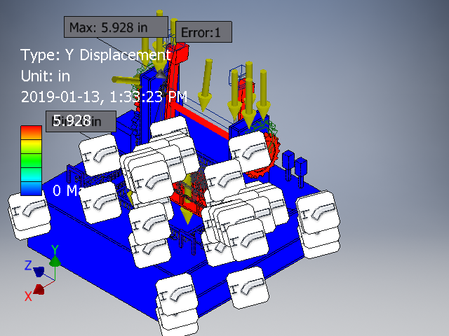
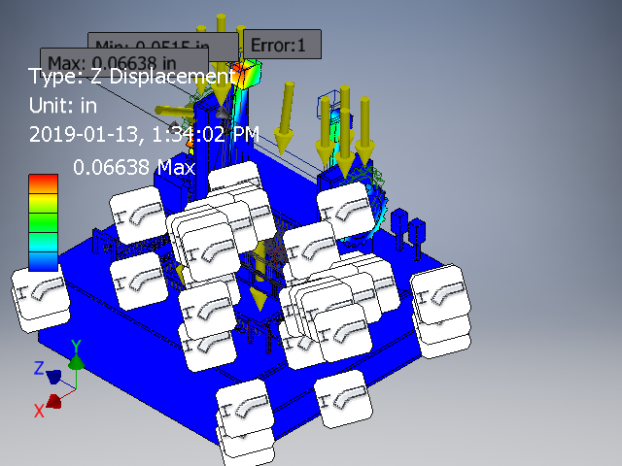
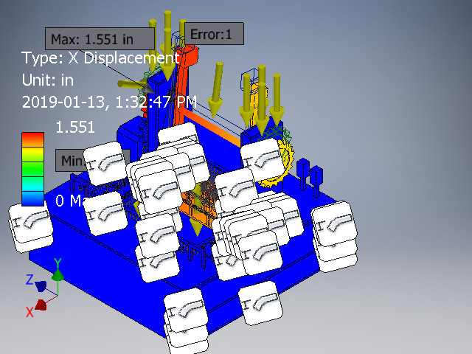
STRESS ANALYSIS
Notes:
Jhanvi

Slide 12
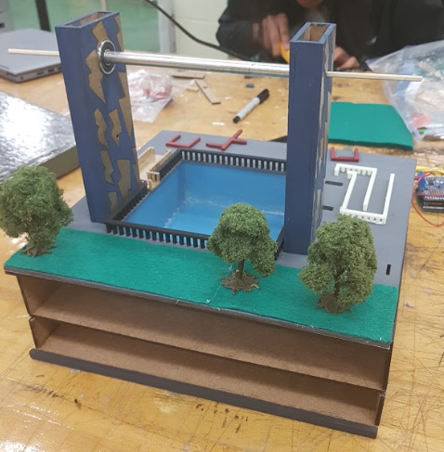
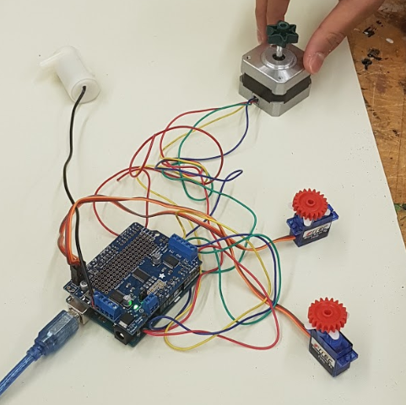
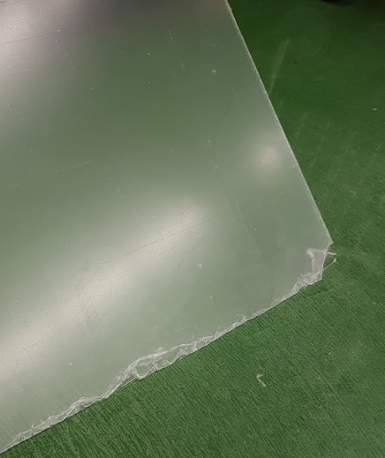
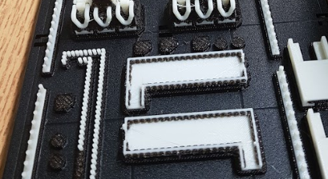
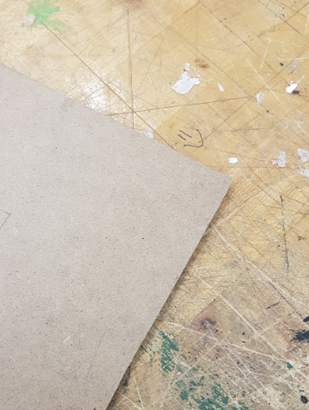
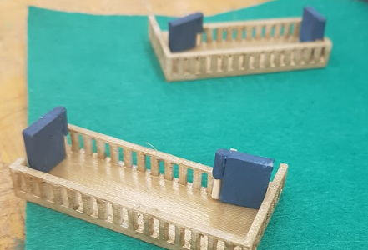
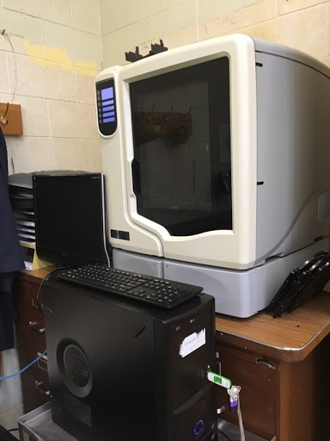
IMPLEMENTING THE SOLUTION
Cutting
Printing
Painting
Circuitry
Assembly
Troubleshooting
Notes:
Mehreen

Slide 13
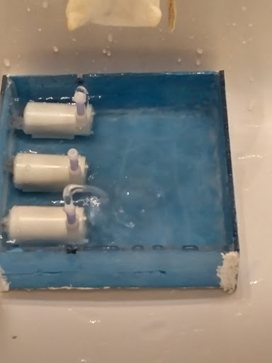
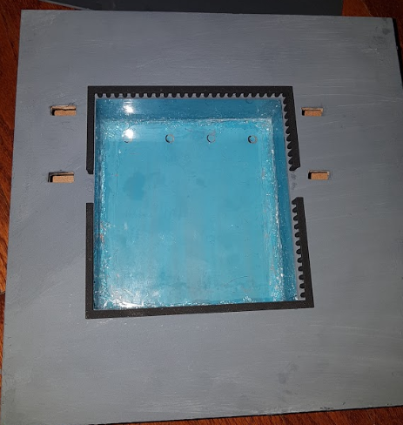
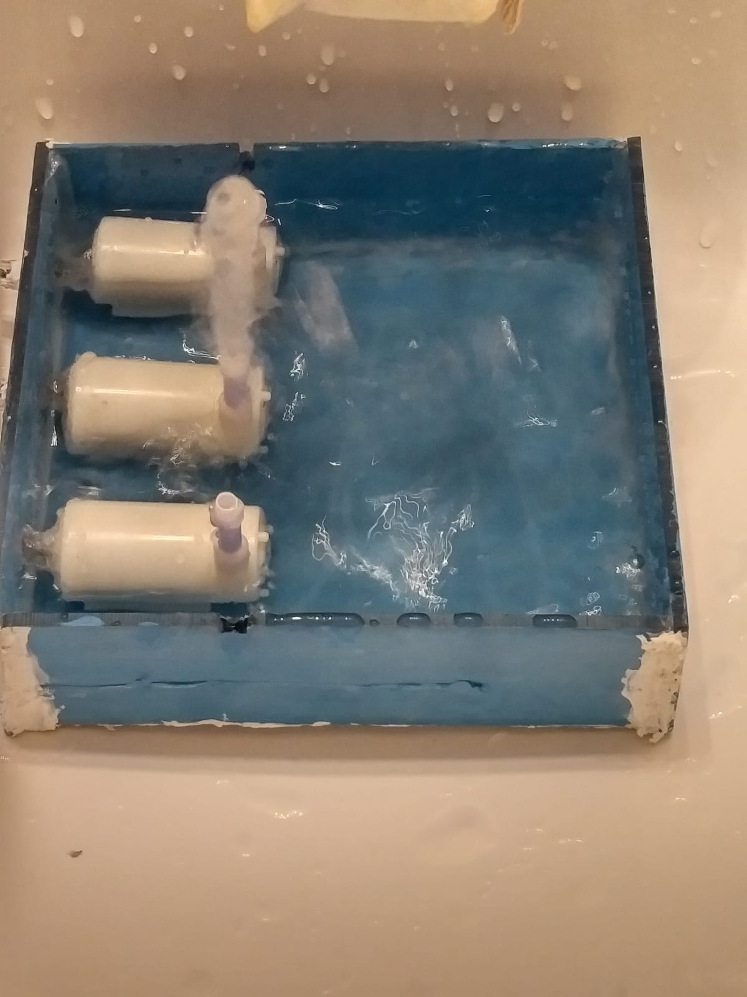
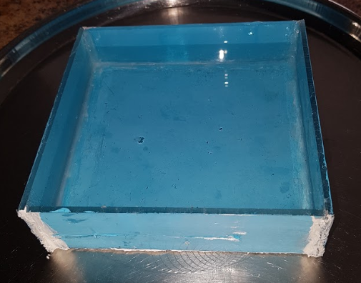
PROBLEMS FACED POOL
Notes:
Jhanvi

Slide 14
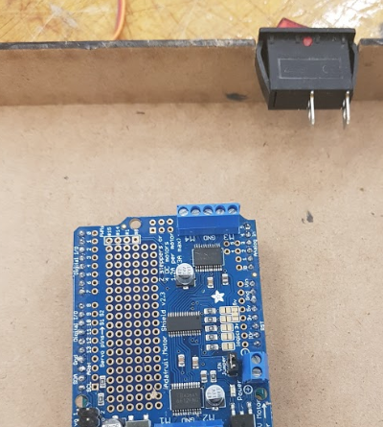
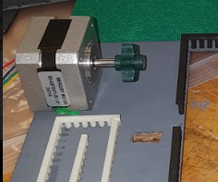
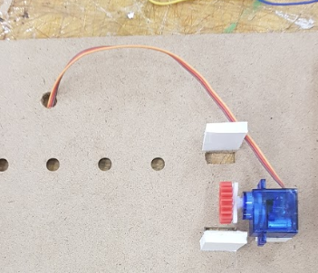
PROBLEMS FACED
Circuitry and Mechanisms
Notes:
Jhanvi

Slide 15
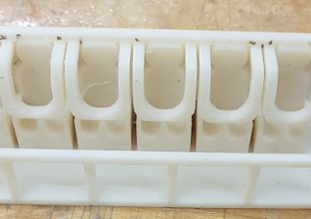


PROBLEMS FACED GONDOLA WEIGHT
Notes:
Mehreen

Slide 16




FINAL PRODUCT
Add motors to actual gondola so there is control over the rotation
Have more control over water pumps
Add lights around the pool and on the ride stands
Scale: 1”: 5’
Notes:
Mehreen

Slide 17
CONTACT US
1
2
3
4
5
Contact Us At:
Website: Click here
Jhanvi Shah 818152@pdsb.net
Mehreen Aiman 740338@pdsb.net
Technical Reports: Jhanvi Shah
Mehreen Aiman
Google Drive Link: Click here

